Slide 1
Digital Human Library

Slide 2
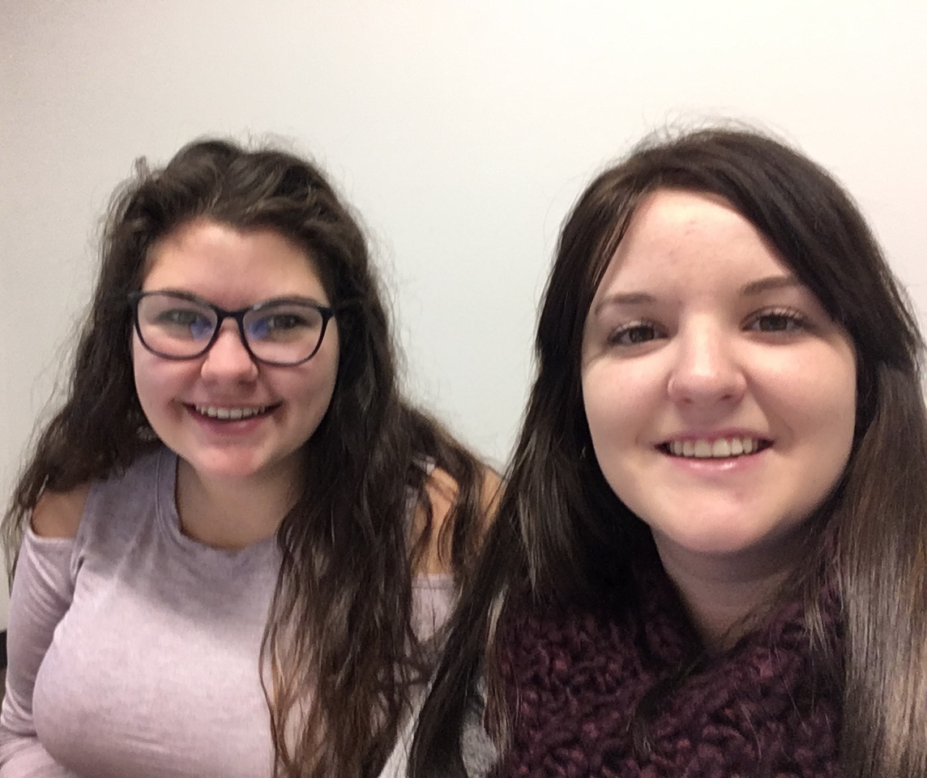

Interns
Rebecca Goorts
Emily Asselin

Slide 3
1.
GRAPHICS
Graphics made to share on social media

Slide 4

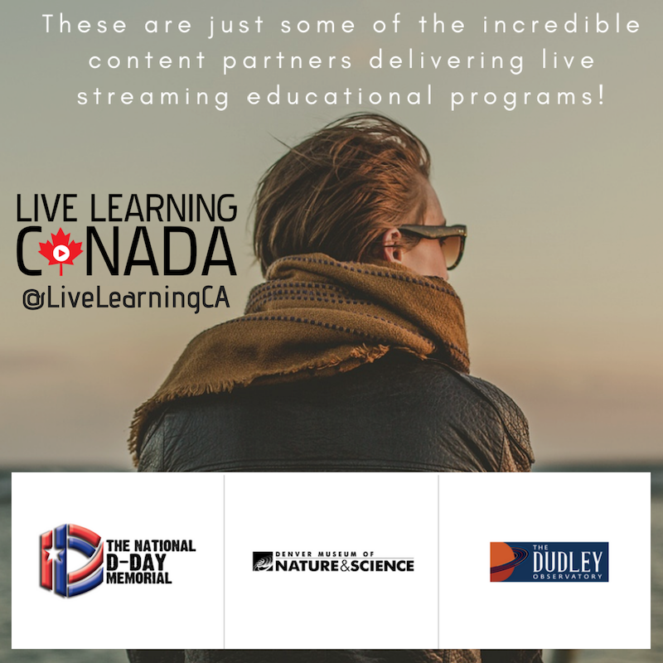
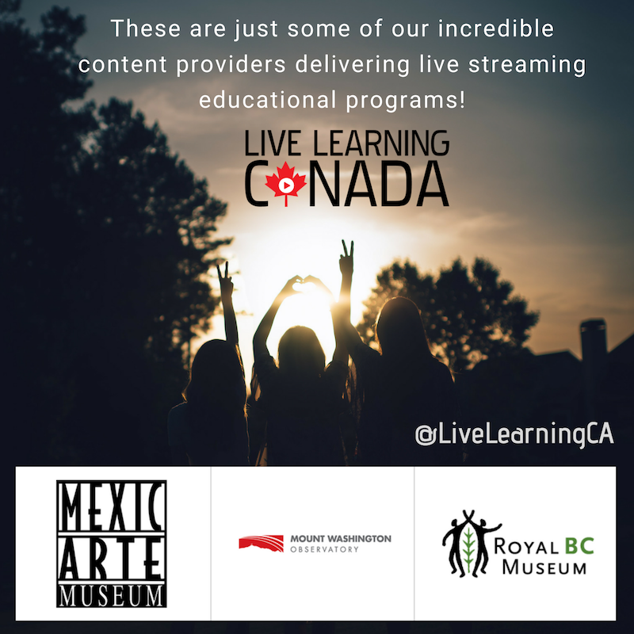

GRAPHICS

Slide 5


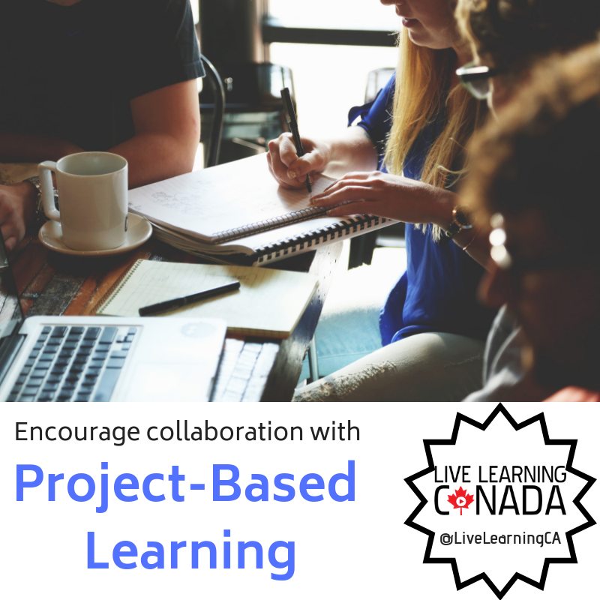

Slide 6
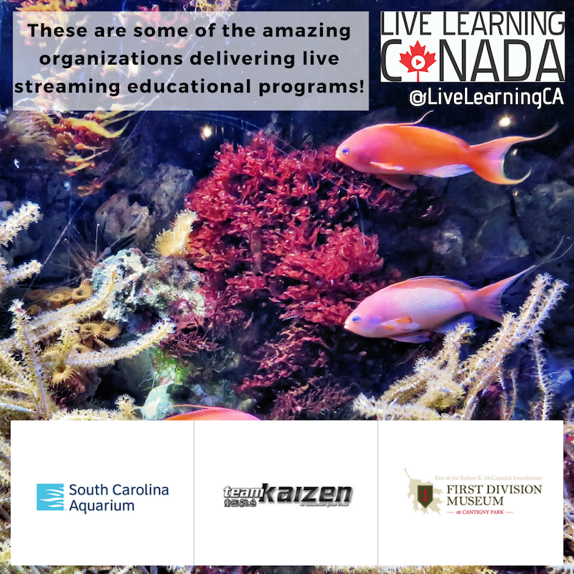


Slide 7
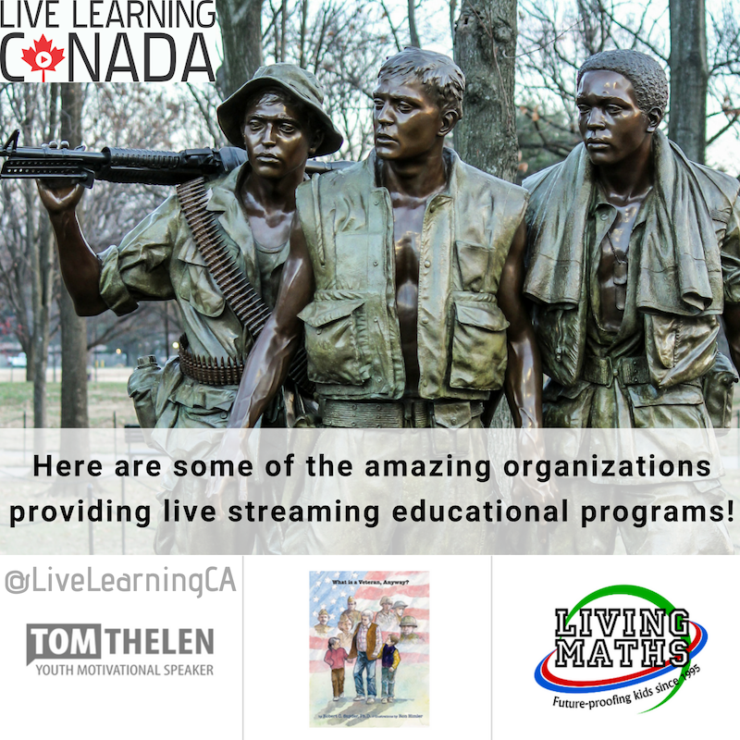


Slide 8



Slide 9



Slide 10
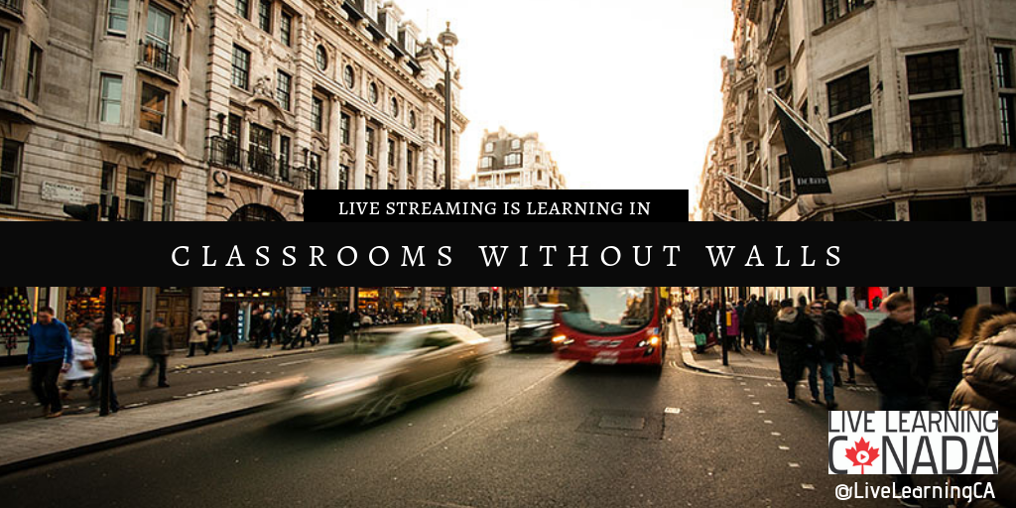

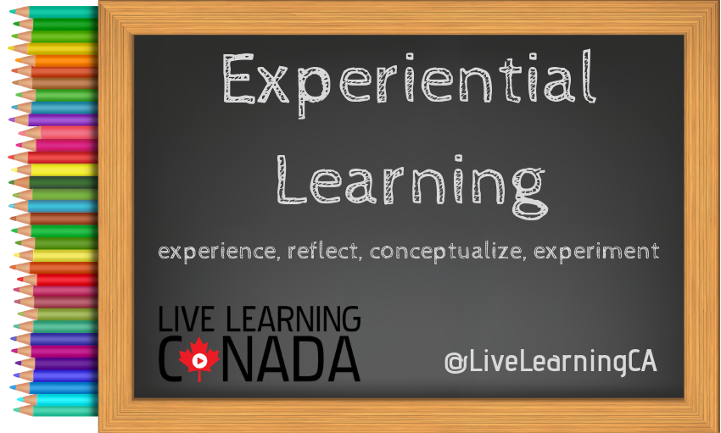

Slide 11
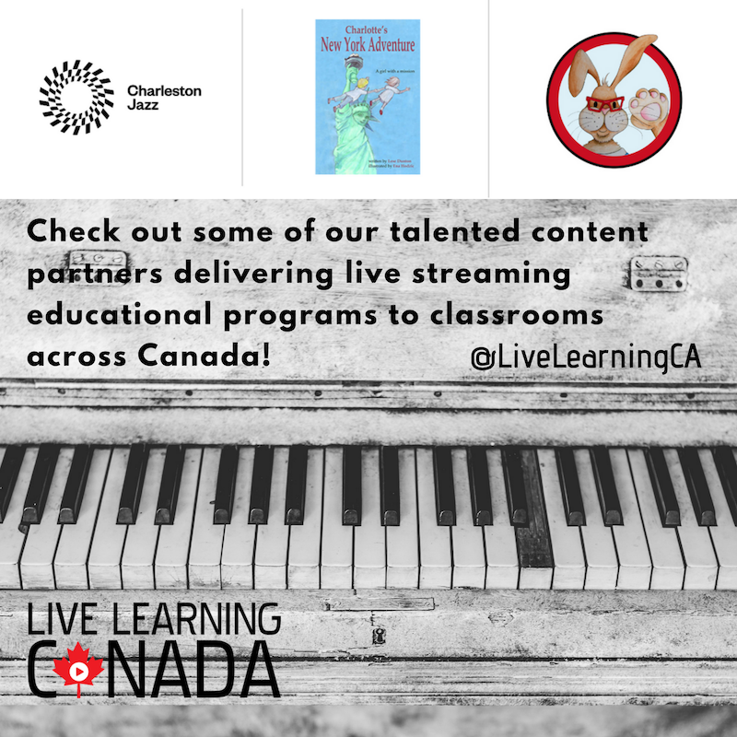
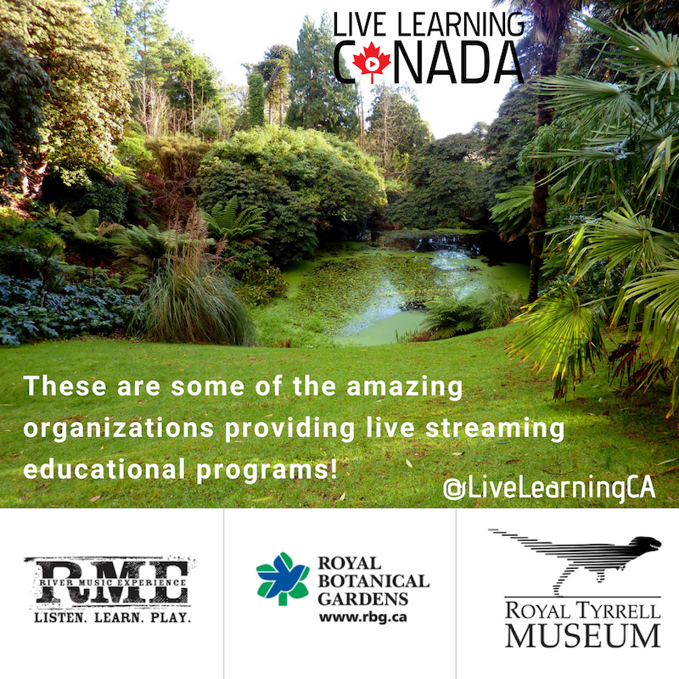

Slide 12

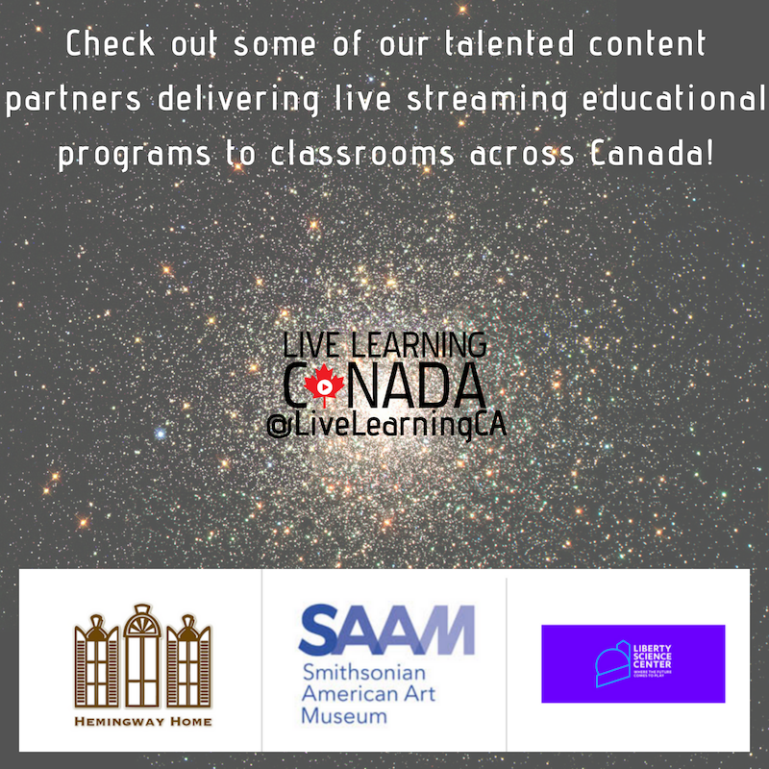

Slide 13

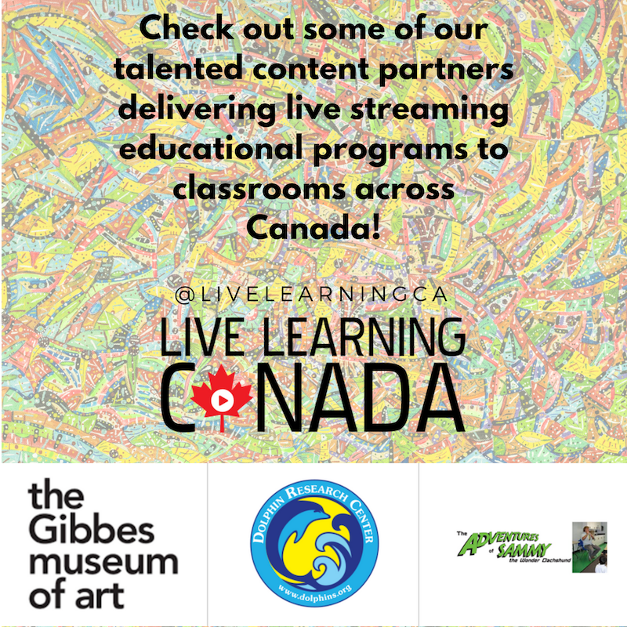

Slide 15



Slide 16

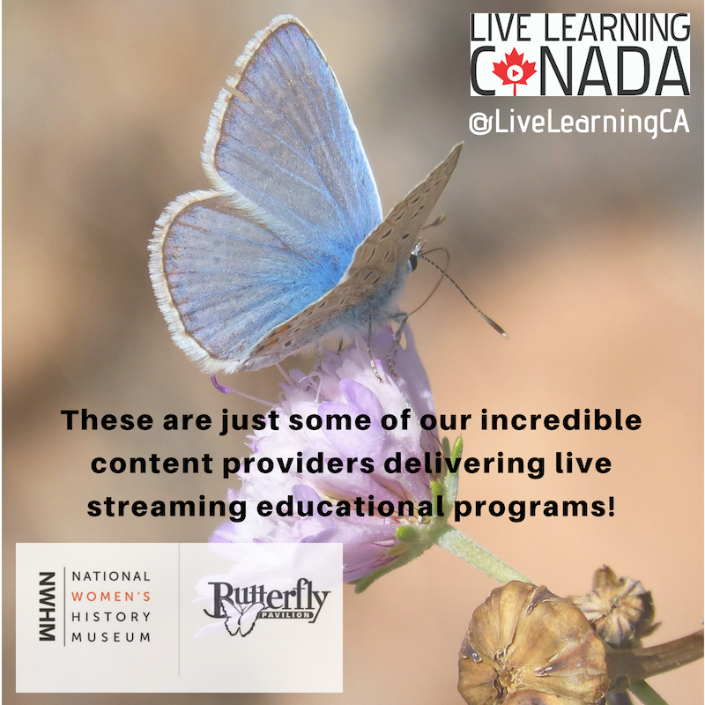

Slide 17
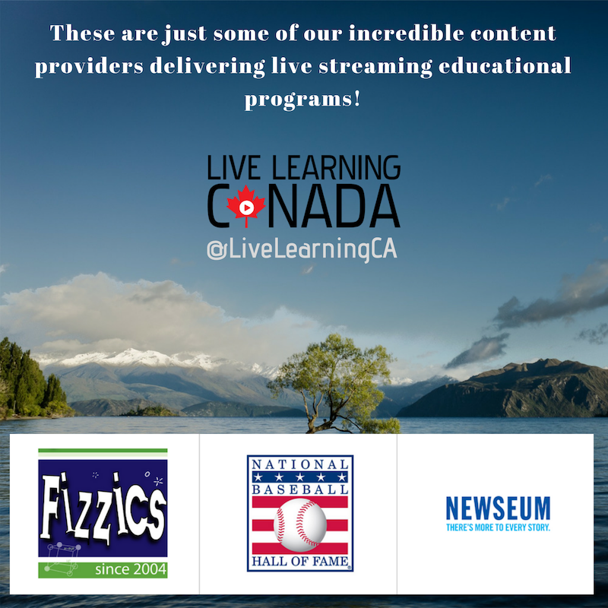
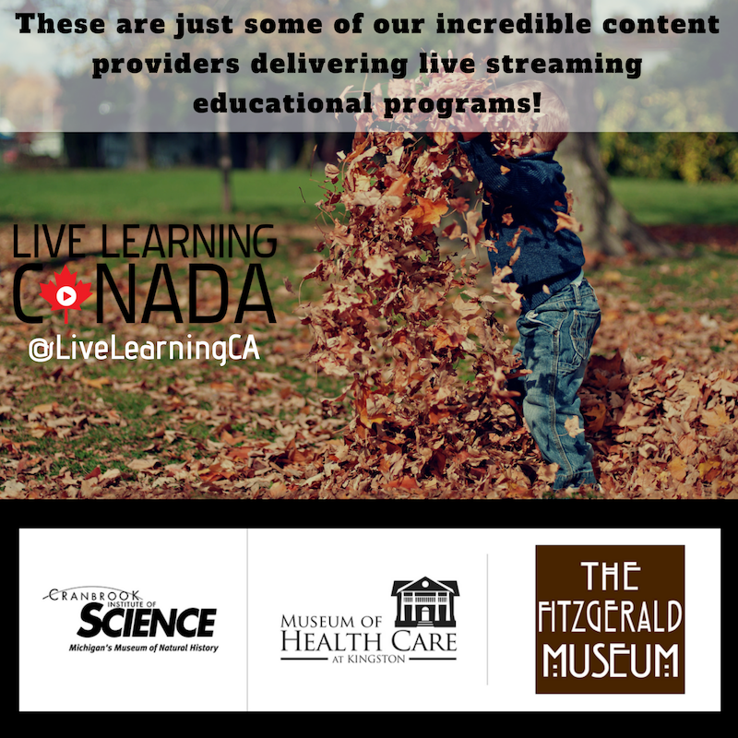

Slide 18
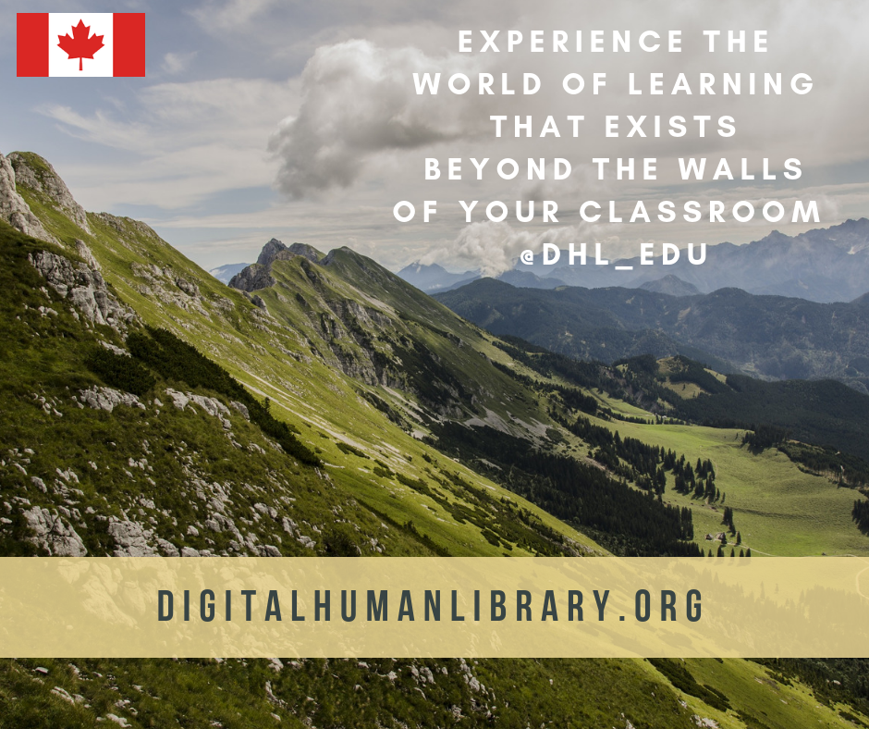
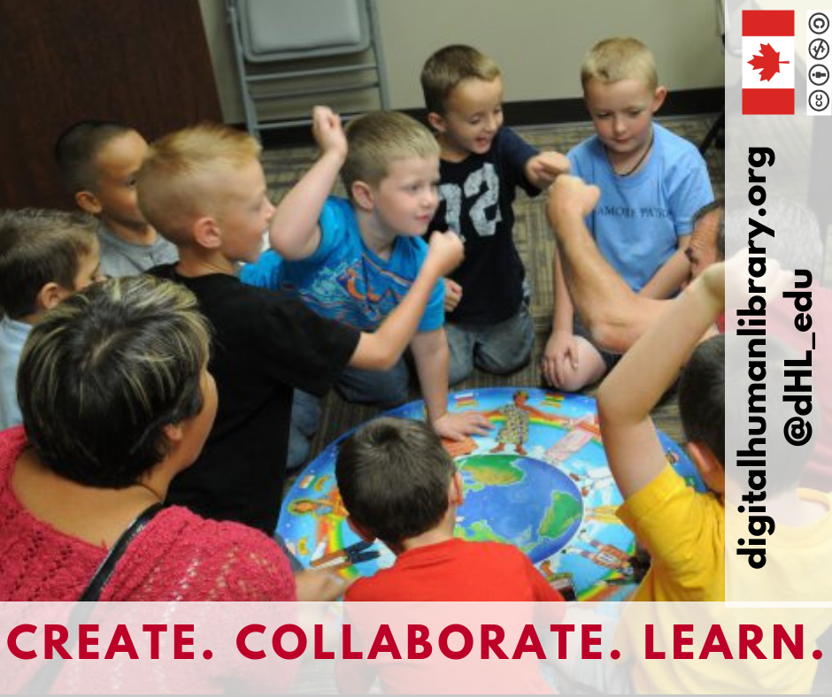

GRAPHICS

Slide 19


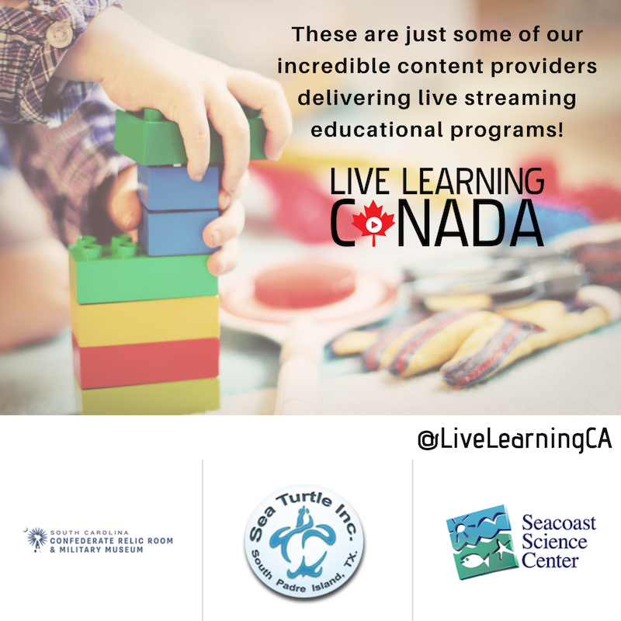

GRAPHICS

Slide 20
2.
PODCASTS
Podcasts to be heard on VoicEd Radio

Slide 21
PODCASTS
Doug Braden
InkSmith
3D Printing
Mark Cheverton
Author
Mindcraft
🎙
🎙
Margaret Boersma
MB Creative Consulting
Theatre Educator
Rachael Bell-Irving
OceanWise
Vancouver Aquarium
🎙
🎙

Slide 22
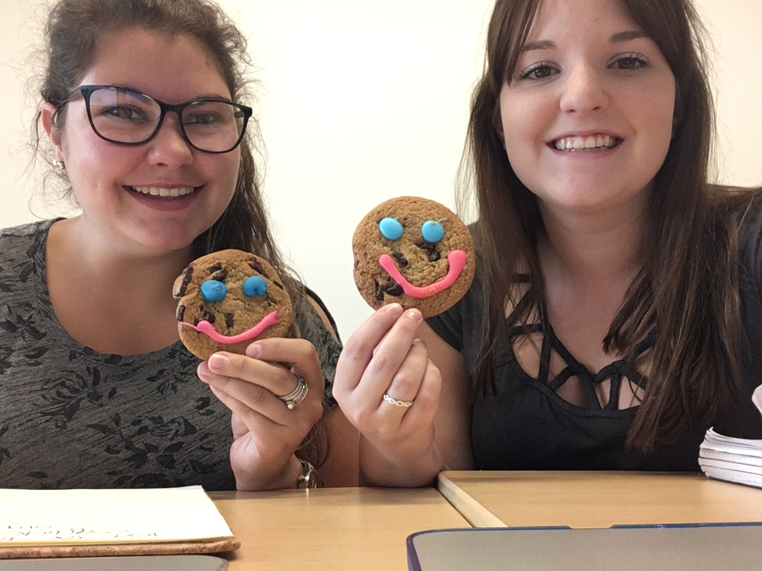
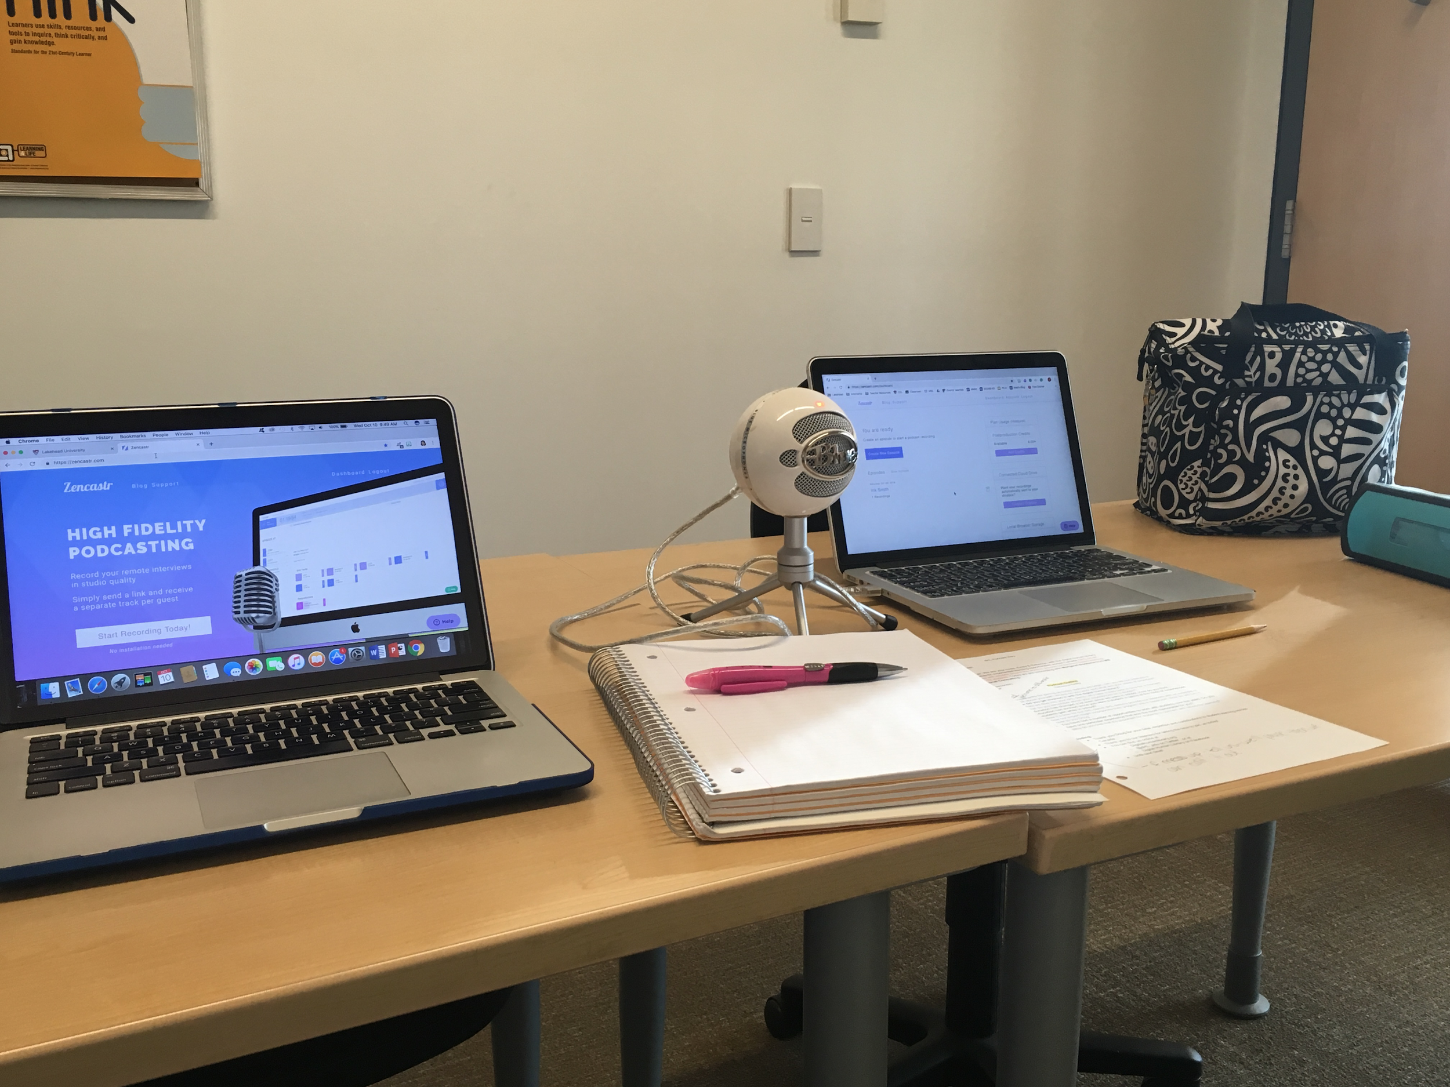

Slide 23
3.
NETWORKING
Researching how networking can be incorporated into classrooms and education

Slide 24
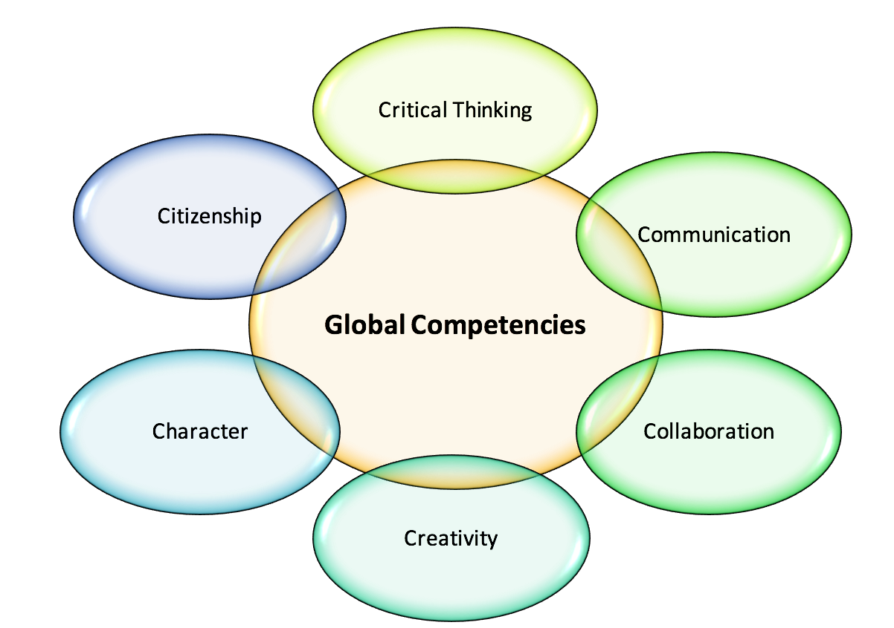

Slide 25
WHY IS NETWORKING IMPORTANT?
Use technology to deepen student understanding
Communicate with students and parents outside of the classroom
Opportunities for students to facilitate learning
Students can collaborate with peers, community partners, and others
Promotes rich conversations
Educating on the growing use of digital literacies
Breakdown the walls of a classroom and use virtual tools to expand student knowledge
Prepares students for 21st Century experiences beyond school

